Slide 1
Collaborative Exhibition Workshop
Building the Way
Forward Together: Towards Stable Meaning and Records Preservation in
Information-Sharing
by
Edwin J. McCeney
Departmental Records Manager
Department of the Interior
18July2007

Slide 2
Capability Maturity Model (CMM)
Functional Background
CMM is divided into 5 Levels of Process Maturity
CMM focuses on systematic process improvement by:
  Developing tools to measure maturity (i.e. maturity questionnaire)
NOTE: Technology can be BAD if focused here
  Focus on the overall model, not catering to specific questions
    Questionnaire identifies both the strengths and weaknesses
    Improvement in the process yields an improved product (goods and/or services)

Slide 3
Capability Maturity Model (CMM)
CMM General Description
  What is CMM?
    Snapshot in business evolution based on evaluation of product or service.
    Framework for process improvement
    Emphasizes standardization of business process to yield a consistent product or service
    Identifies areas of relative strength and weakness of the process through the quality of the product or service
    Qualities of change that improve a business process
    Basis for a Gap Analysis
  What CMM is not?
    Not a cookbook recipe
    Not bound by specific technology
    No single answer to achieve process improvement

Slide 4
Federal Records Act
Capability Maturity Model (CMM)
What is the CMM?
What are the Proposed Maturity Levels?
What are the Next Steps?
OCIO IM Division
Wisdom
Knowledge Management
Records
Information Management
Privacy Act
Authoritative Data Base (Data Management)
FOIA
Web Solutions
Portals
Access/Quality

Slide 5
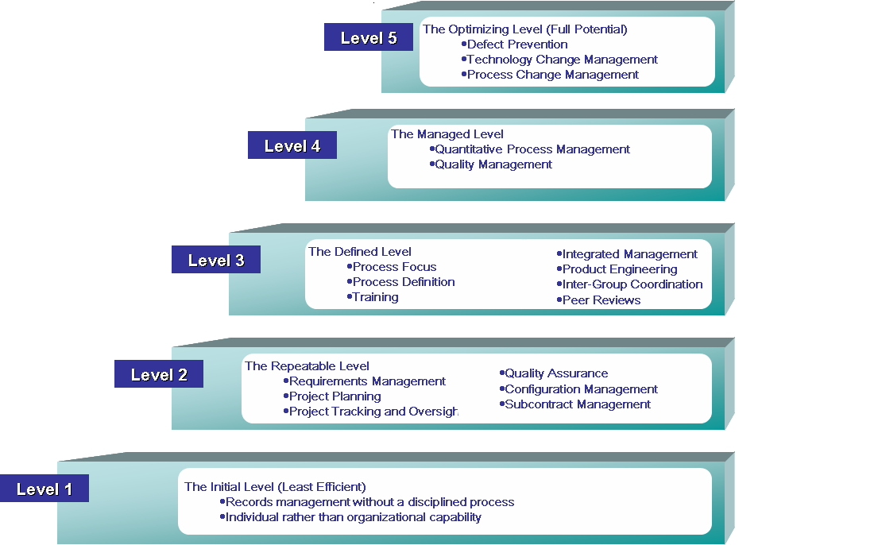
Capability Maturity Model (CMM)
Manage Expectations: Typical time between levels is 2-3 years.

Slide 6
Key Process Maturity Areas
Process Capability
Indicate
Maturity Levels
Significant records management enhancement to perform a process (A series of outcomes that reflect a capability)
Contain
Organizational
Goals
Key Process Areas
Organization achieves the institutional goals for records management (Related outputs that achieve an outcome)
Achieve
Organized By
Implementation or
Institutionalization
Common Features
Desired Records Management practices are incorporated into various aspects of a specific key process (producing a series of related outputs)
Address
Contain
Infrastructure or
Activities
Describe
Key Practices
Important records management practices are identified and defined (associated and repeatable activities to produce a single output)

Slide 7
Records Management Maturity Levels
Description and Details
5: Leveraging IT for strategic outcomes (Full Potential)
  Implement legal and judicial records management mandates
  Respond to records management mandates
  Improve records management performance
4: Improving the records management process
  Management compliance for system records
  (within an approved schedule)
3: Developing a complete records management schedule
  Define the portfolio records management criteria
  Creating the records management portfolio schedule
  Submitting records schedule to NARA
  Conducting system review for records management compliance
2: Building a records foundation
  Form a records council and have regular meetings
Ensure that records management captures business
processes and products in strategic plans
  Bureau Records Officer system review
  Capture critical records metadata
1: Initial (Least Efficient)

Slide 8
Capability Maturity Model (CMM)
CMM Records Management Application
10 Factors for Records Management Process Improvement
  1. Recordkeeping behavior (overall understanding at all levels)
  2. RM Policies and Procedures (organizational level)
  3. Record Format (media)
  *4. Records Inventory (description)
  *5. Records Schedules (legal management)
  6. Records Retirement (non-active, storage)
  *7. Records Disposition, Location and Retrieval (management)
  8. Vital Records (emergency preparedness)
  9. RM Training
  10. Management and Culture (importance to management)
Factors are less discrete at higher levels
Factors interplay with each other especially at the higher levels

Slide 9
RM CMM Levels improve processes for
tactical and strategic project management
  Tactical: Uniform record fields and descriptions can facilitate data standardization through a record/data encyclopedia (both within and across agencies)
  Strategic: Total records lifecycle costing can be reduced and more accurately measured
  Future: Records Management becomes part of a brokered information service with value-added options based on search criteria

Slide 10
Capability Maturity Model (CMM)
Questions???
Contact Information:
  Edwin McCeney
    Department of the Interior
    Email: Edwin_Mcceney@ios.doi.gov
    Phone: (202) 208-3321

